Slide 1
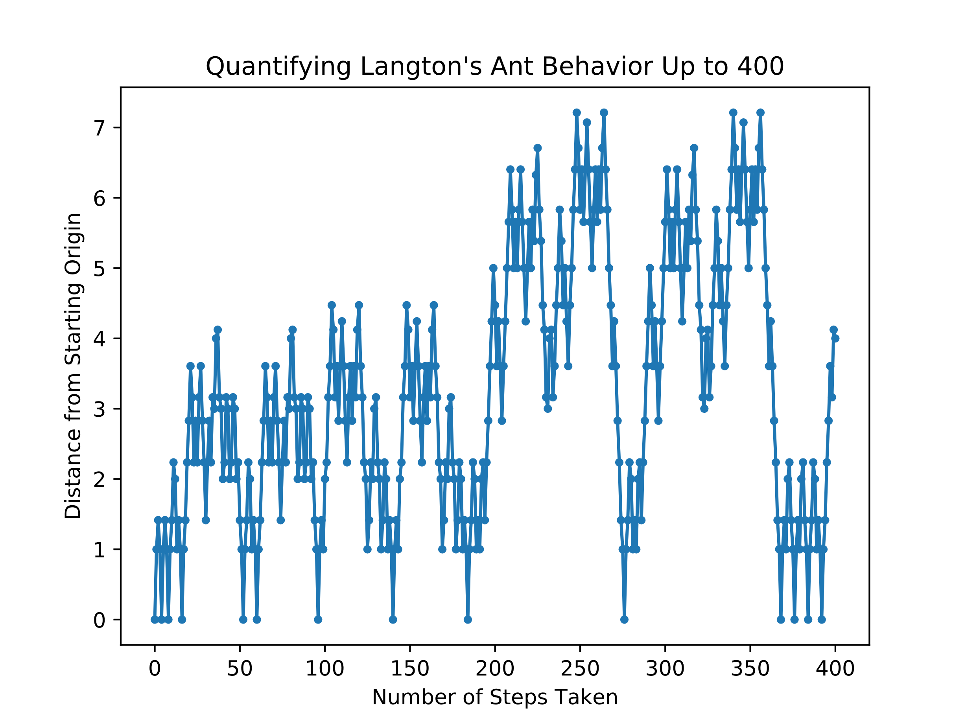
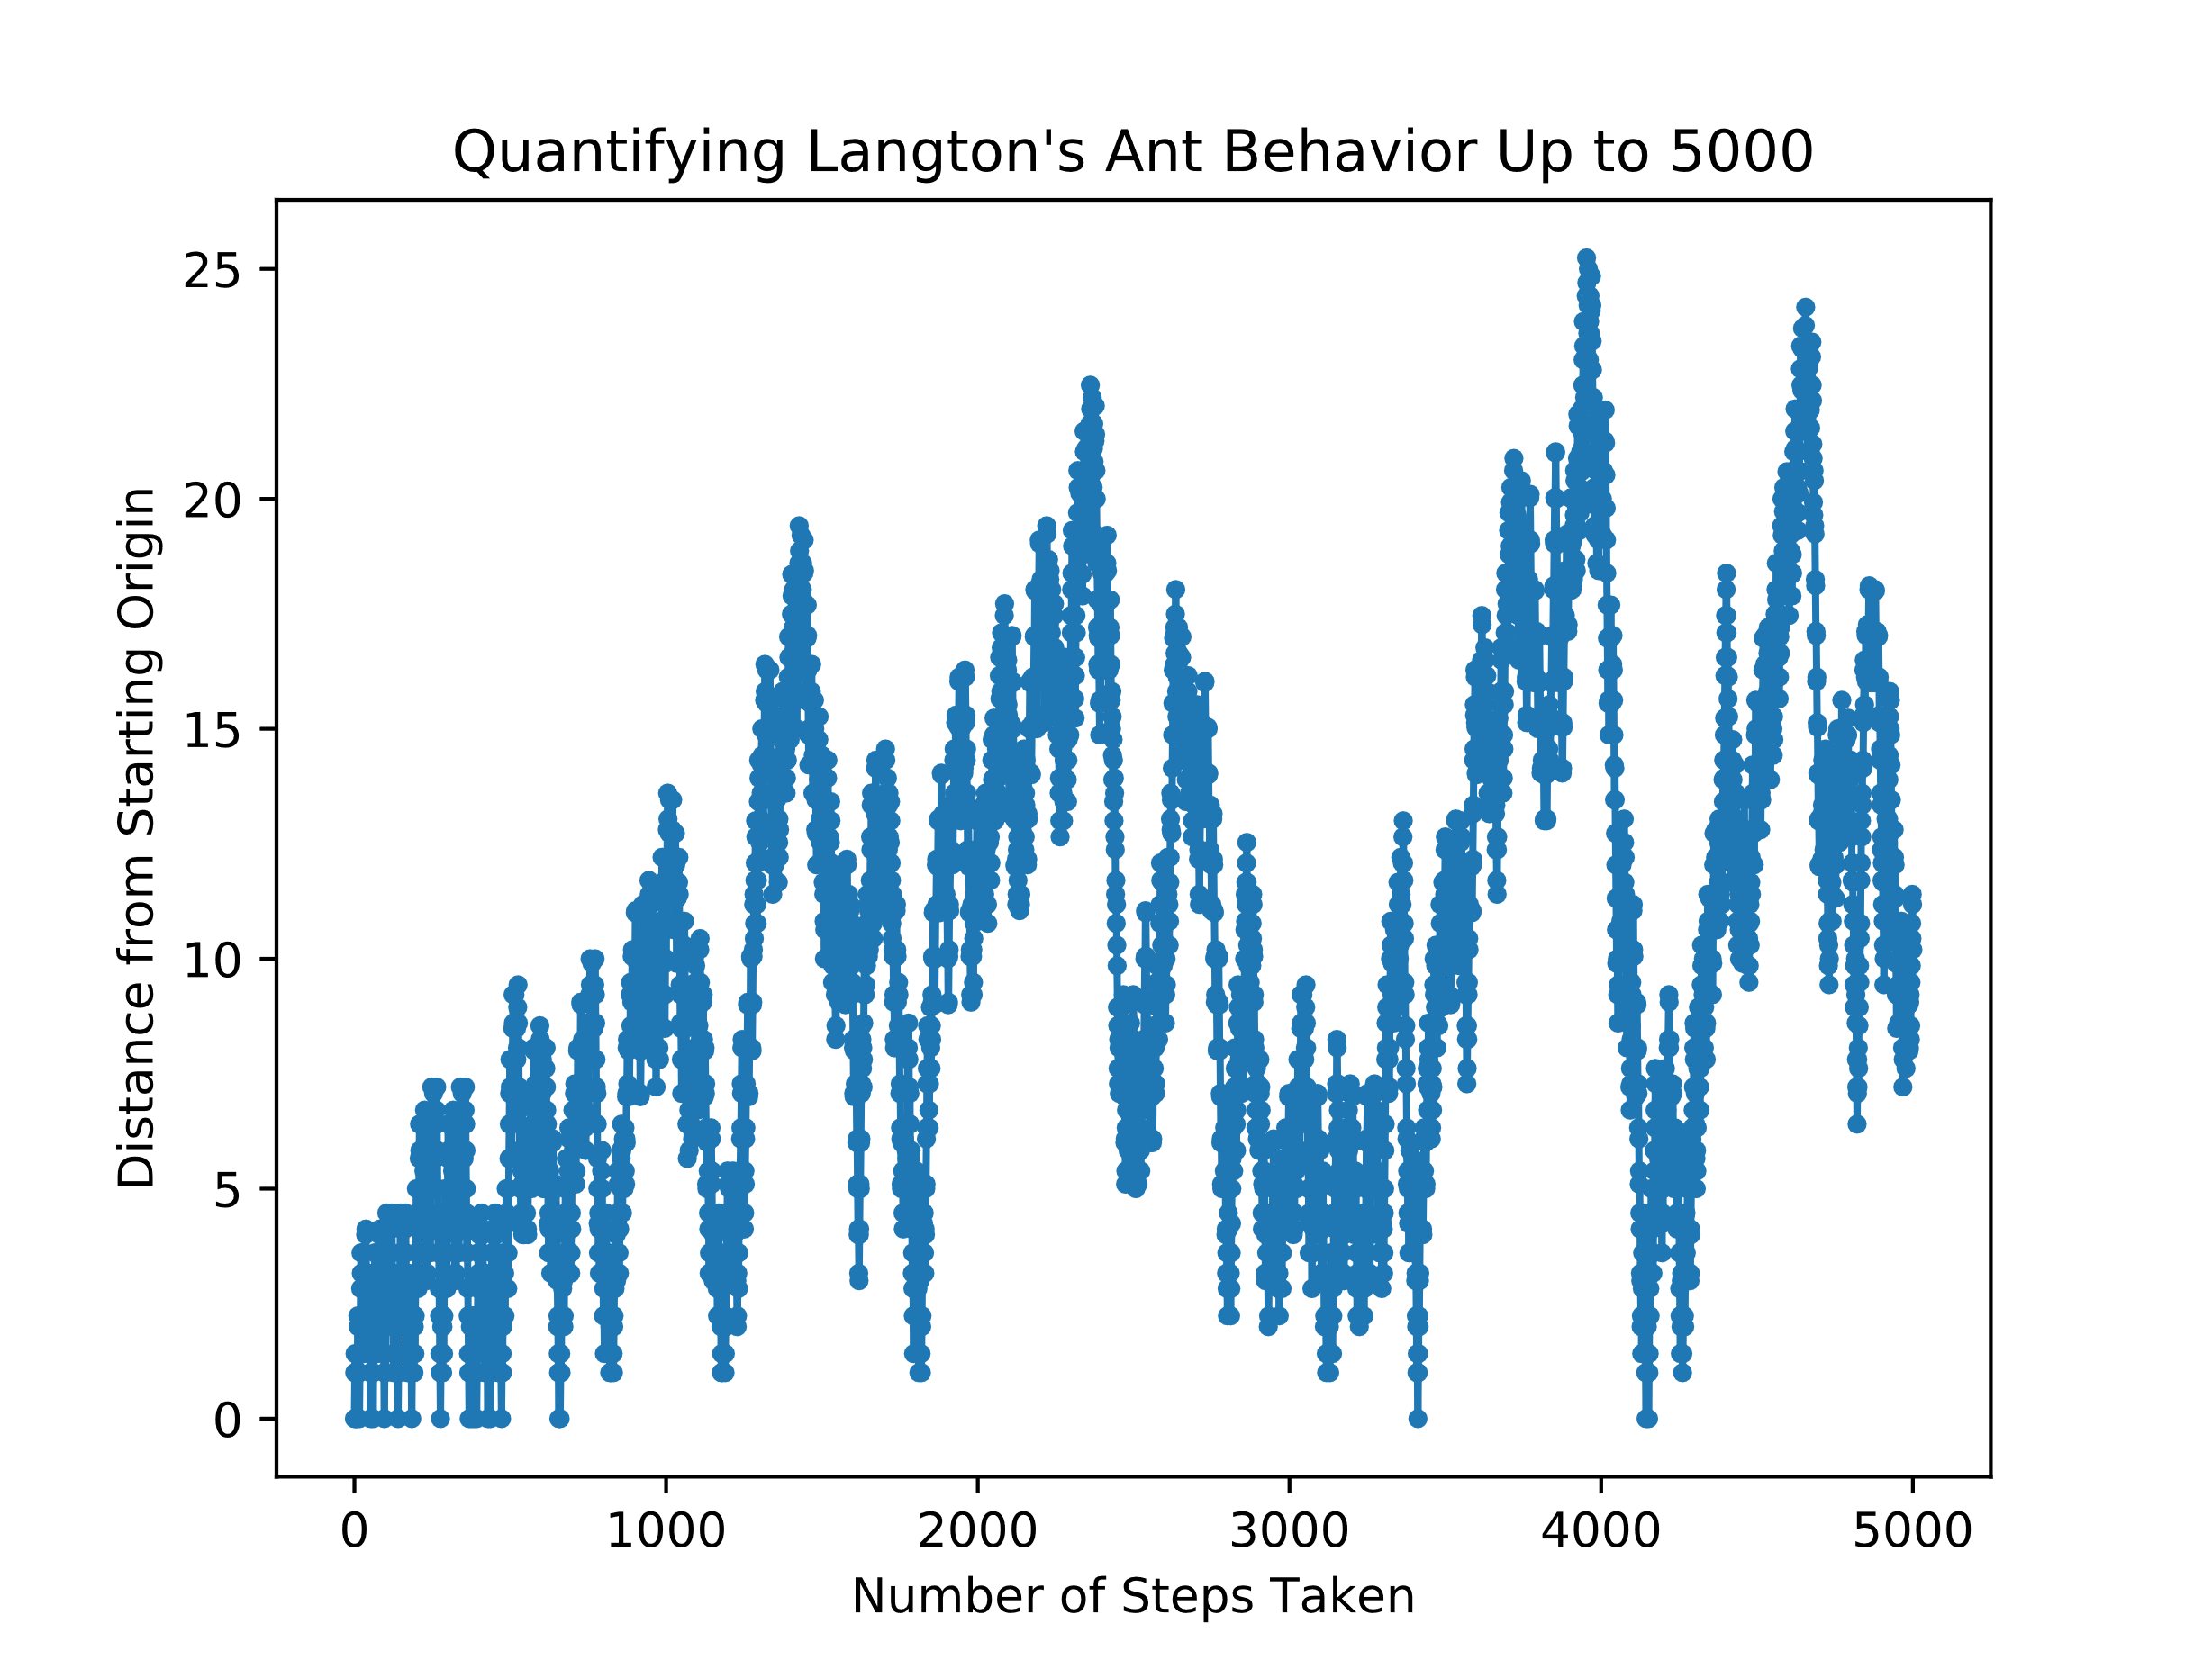
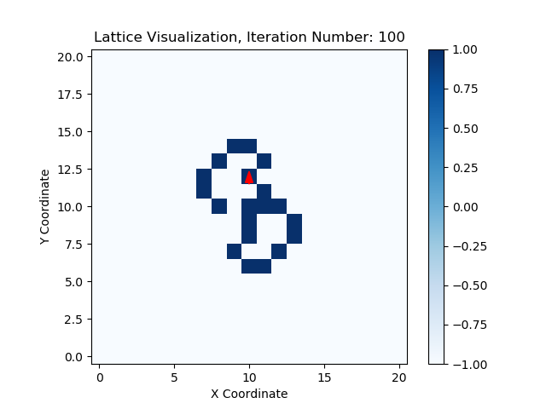
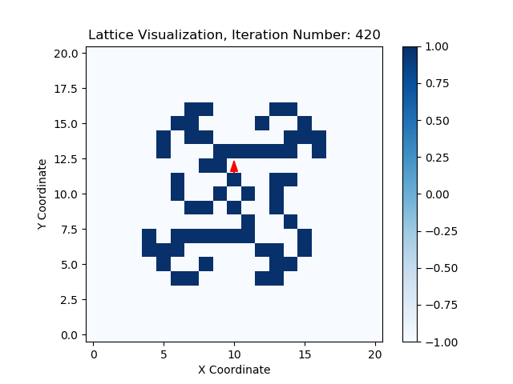
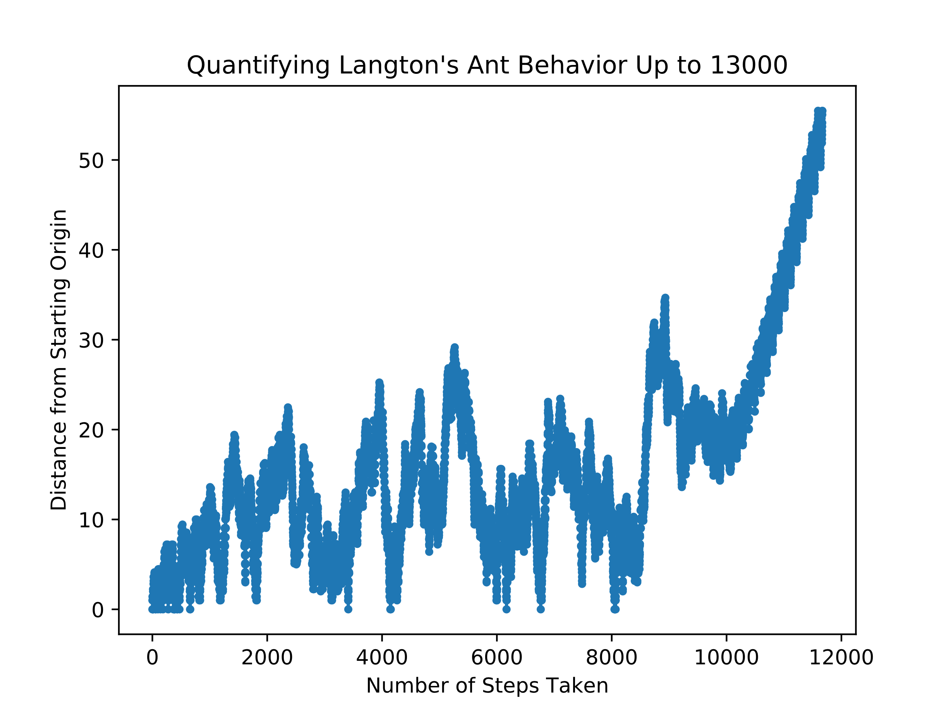
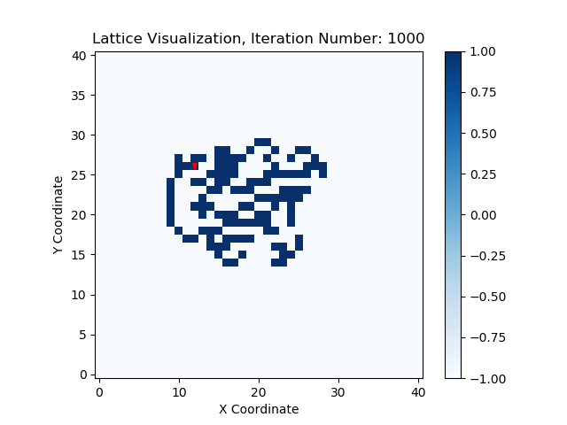
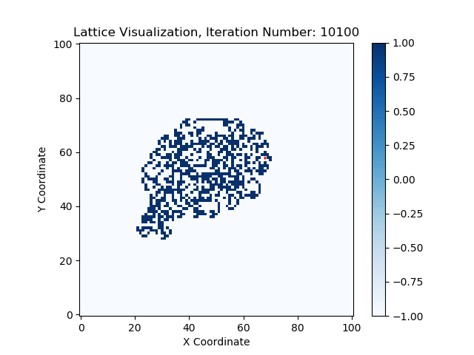
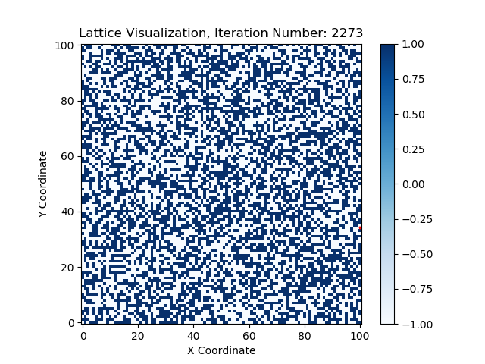
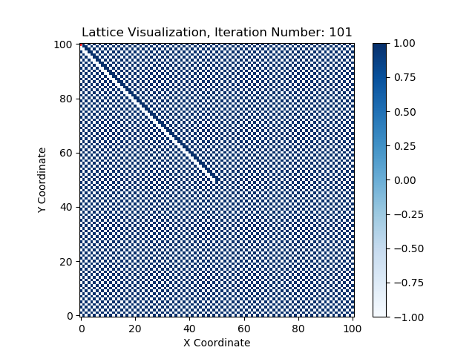
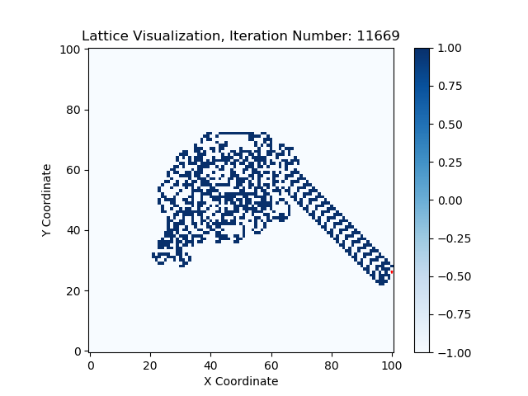
Langton’s Ant
Hope Lee
Introduction
Quantifying Behavior
Langton’s Ant is a variety of cellular automata, similar to Conway’s game of Life. The set-up and rules for Langton’s Ant’s basic algorithm is very straightforward. The simulation consists of a grid whose cells can be either black or white, with basic simulations starting with a fully white grid. An ant is then positioned at some initial starting location and its subsequent motion governed by two rules:
If at a white cell, turn 90 degrees right, flip the cell color, then move forward one cell
If at a black cell, turn 90 degrees left, flip the cell color, then move forward one cell
Phases of Behavior
Randomness and Order in Initial Lattice
References

Slide 2
A novel image encryption scheme using chaos and Langton’s Ant cellular automaton
Xingyuan Wang
Dahai Xu

